Slide 1





prioritizr Systematic conservation planning in
prioritizr.net
Jeffrey Hanson & Richard Schuster
jeffrey.hanson@uqconnect.edu.au
richard.schuster@glel.carleton.ca

Slide 2


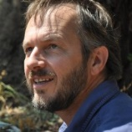
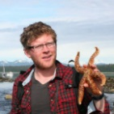
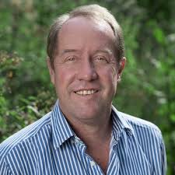


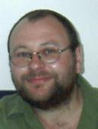



Acknowledgements
Jeff Hanson
Matt Strimas-Mackey
Nina Morrell
Matt Watts
Joe Bennett
Peter Arcese
Hugh Possingham

Slide 3

The Why?
Conservation planning = challenging
Range of objectives and constraints
Analytical tools tailored to specific tasks
Proposal:
Flexible, powerful framework
+ User friendly (browser) interface
Notes:
researchers, managers, and stakeholders must consider a range of different objectives and constraints, and require analytical tools tailored to specific tasks.

Slide 4
Why ?
It’s free
Reproducibility
Flexible interface
Diverse package ecosystem
So many resources: Stackoverflow, tutorials, blogs, twitter, slack channels, mailing lists

Slide 5

prioritizr
Design your problem
Find optimal solutions
Ideally, fast!

Slide 6
Decision science
Goal: what is our vision for the future?
Objective: what quantity are we maximizing/minimizing to help achieve the goal?
Constraints: what things must our solution do to help achieve the goal?
Decisions: what actions could we do to maximize/minimize the objective?

Slide 7





Case-study: Reserve design
Goal: conserve biodiversity
Objective: min. # of islands
Constraints: sufficient habitat for each species
Decisions: which places should be protected?

Slide 8
prioritzr features
https://prioritizr.net/articles/prioritizr.html#package-overview
Objectives
Targets
Constraints
Penalties
Decisions
Solvers
Solution portfolios
Irreplaceability
Single zone
Multi zone
Extensive documentation with lots of tutorials and examples: prioritizr.net

Slide 9
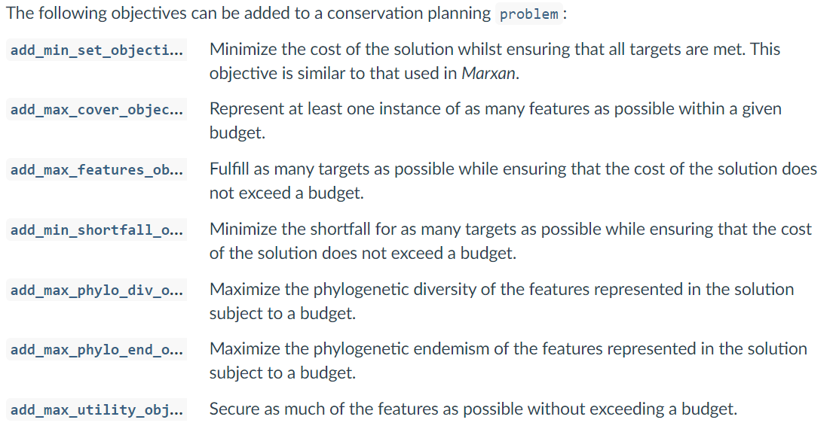
Objective functions https://prioritizr.net/reference/objectives.html

Slide 10
Penalties https://prioritizr.net/reference/penalties.html
boundary penalties = symmetric
connectivity penalties = asymmetric allowed

Slide 11
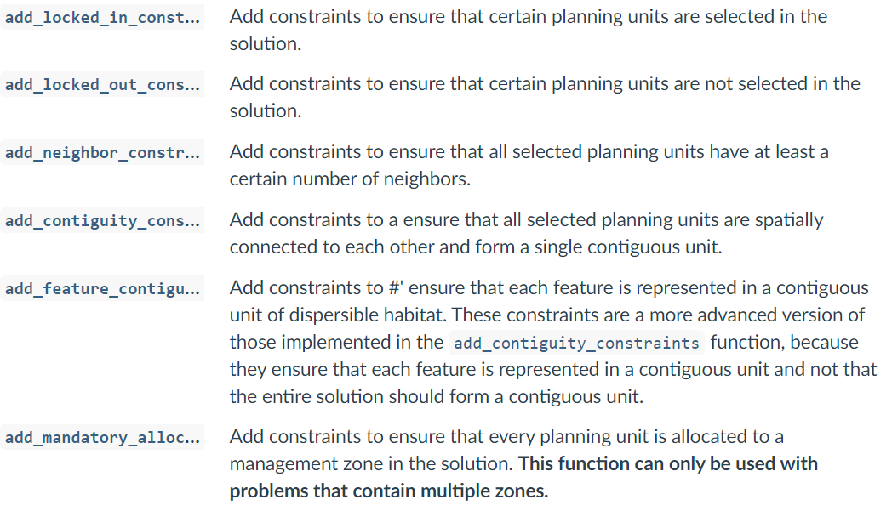
Constraints https://prioritizr.net/reference/constraints.html

Slide 12
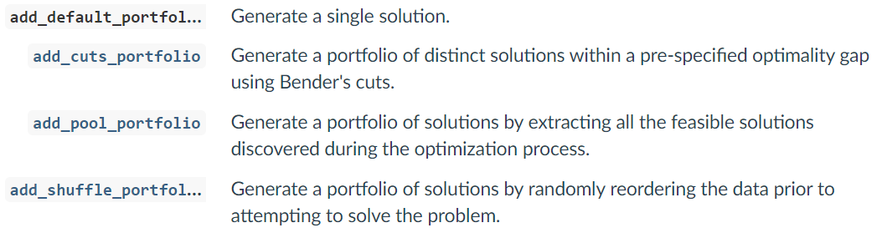
Portfolios https://prioritizr.net/reference/portfolios.html

Slide 13
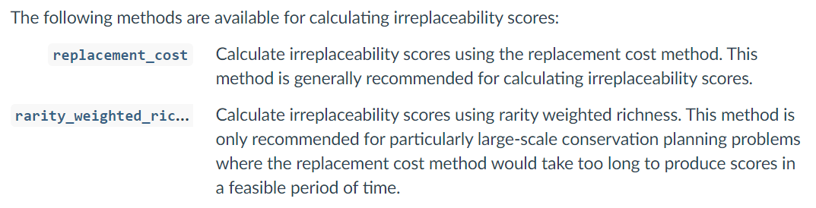
Irreplaceability https://prioritizr.net/reference/irreplaceability.html
In progress: Ferrier et al. (2000) summed irreplaceability

Slide 14
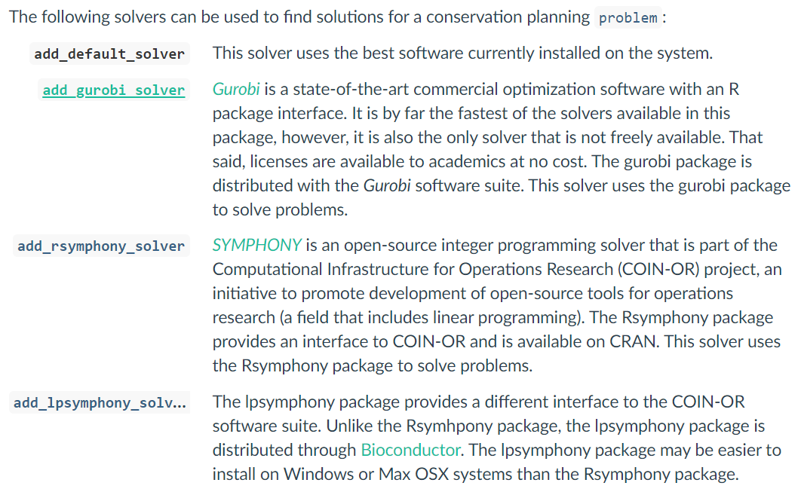
Solvers https://prioritizr.net/reference/solvers.html

Slide 15
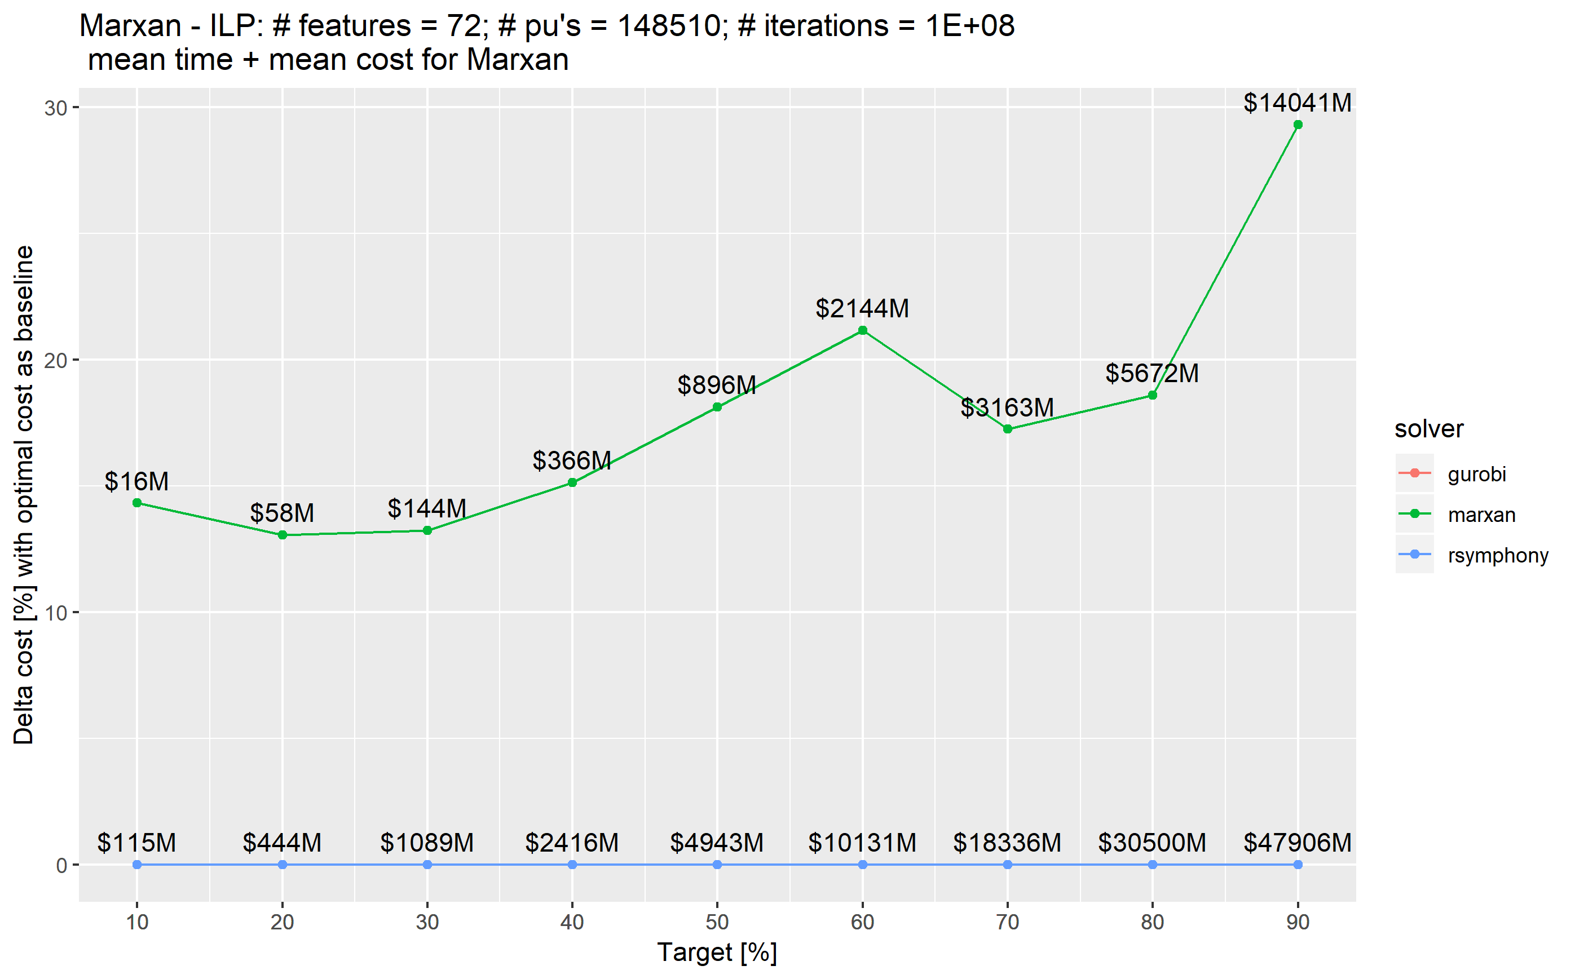
Exact algorithms guarantee optimality
Schuster et al.
(in review)

Slide 16
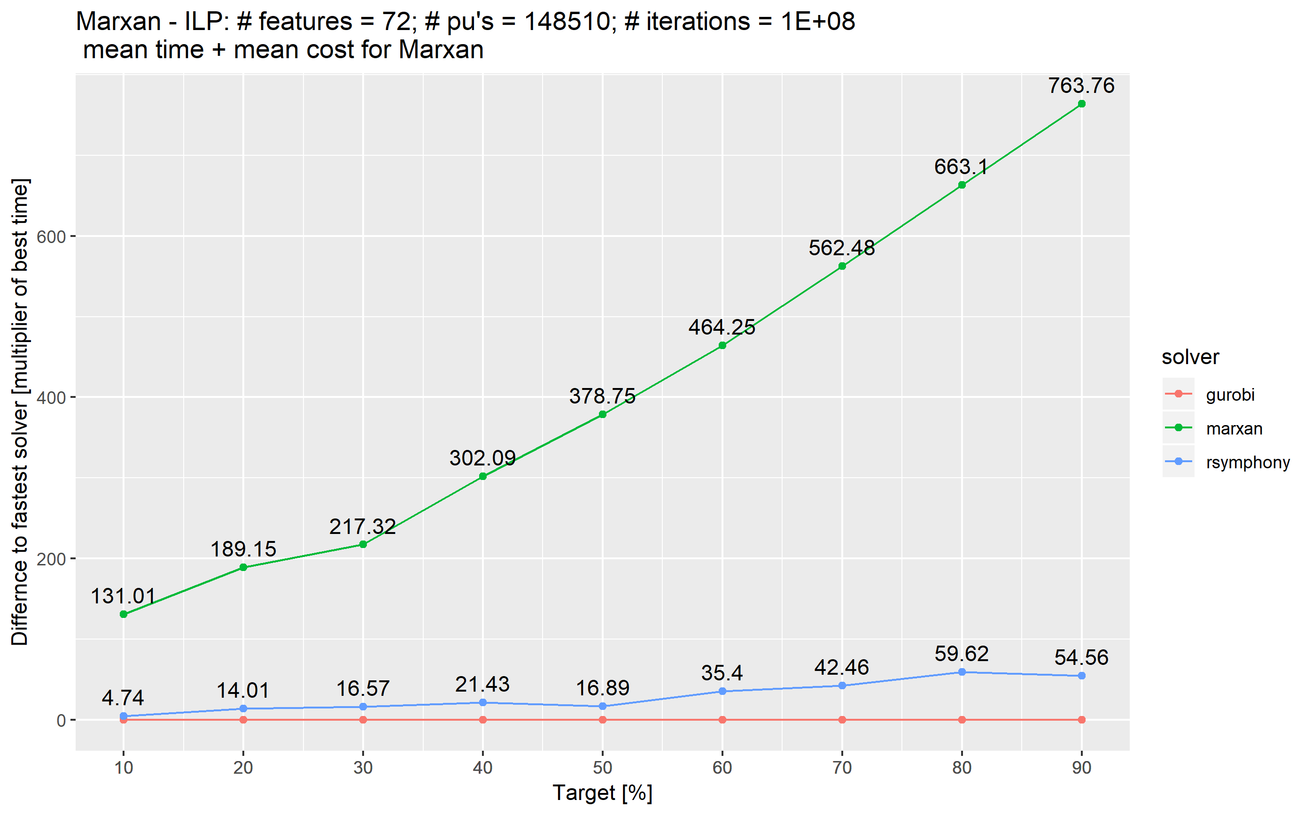
Exact algorithms are fast
Schuster et al.
(in review)

Slide 17
Human-readable code
Mental model
problem <- data +
objective +
constraints +
penalties +
decision type +
solver
solution <- solve(problem)

Slide 18
Human-readable code
Mental model
Code
problem <- data +
objective +
constraints +
penalties +
decision type +
solver
solution <- solve(problem)
p <- problem(areas, feats) %>%
add_min_set_objective() %>%
add_relative_targets(0.1) %>%
add_boundary_penalties(5) %>%
add_binary_decisions() %>%
add_rsymphony_solver()
solution <- solve(p)

Slide 19
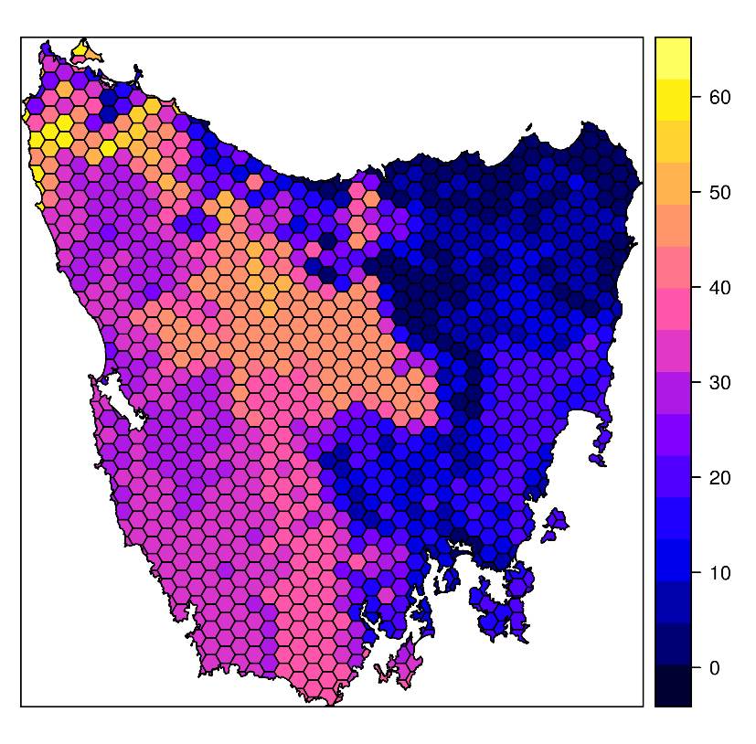
Design your problem
Study area: Tasmania, Australia
Planning units: 1130 hexagons
Features: 63 vegetation types

Slide 20
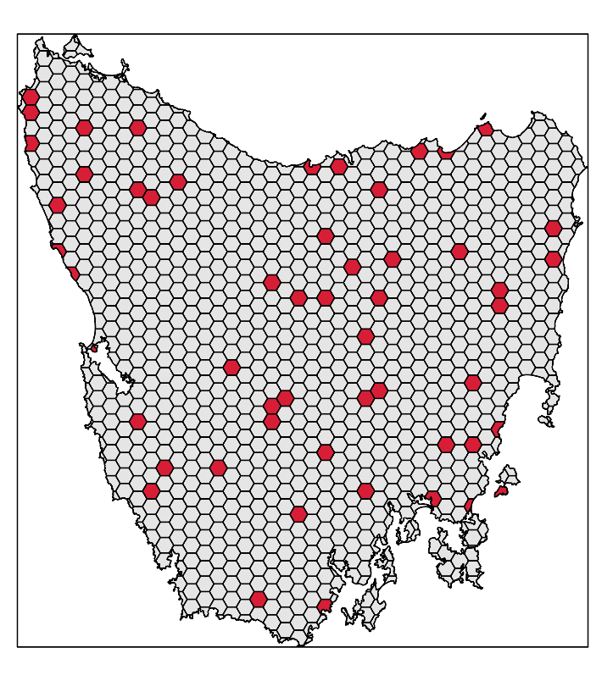
Design your problem
problem(tas_pu, tas_features,
"cost") %>%
add_min_set_objective() %>%
add_relative_targets(0.1) %>% add_binary_decisions() %>%
add_gurobi_solver(gap = 0) %>% solve()

Slide 21
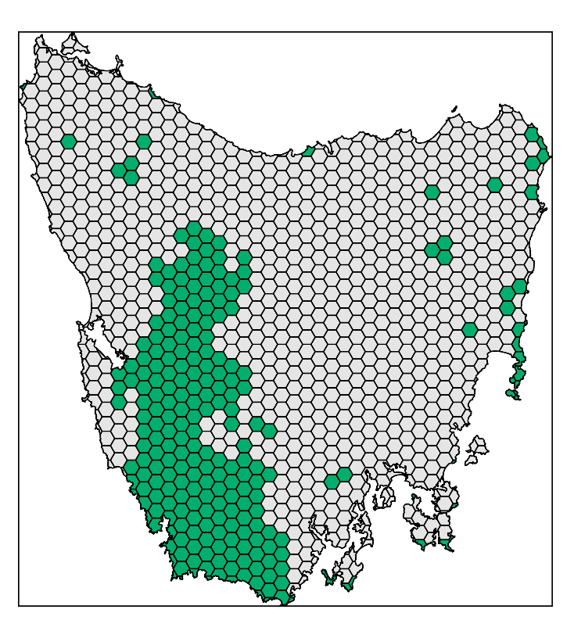
Design your problem
problem(tas_pu, tas_features,
"cost") %>%
add_min_set_objective() %>%
add_relative_targets(0.1) %>% add_locked_in_constraints("in") %>%
add_binary_decisions() %>%
add_gurobi_solver(gap = 0) %>% solve()

Slide 22
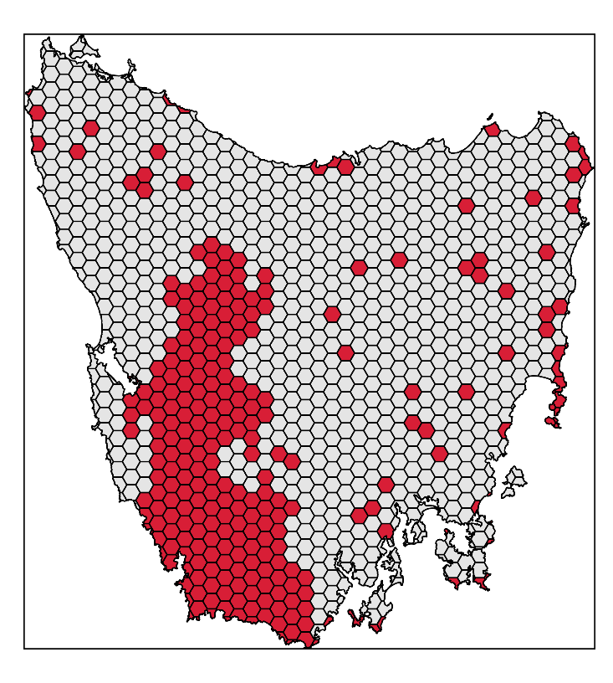
Design your problem
problem(tas_pu, tas_features,
"cost") %>%
add_min_set_objective() %>%
add_relative_targets(0.1) %>% add_locked_in_constraints("in") %>%
add_binary_decisions() %>%
add_gurobi_solver(gap = 0) %>% solve()

Slide 23
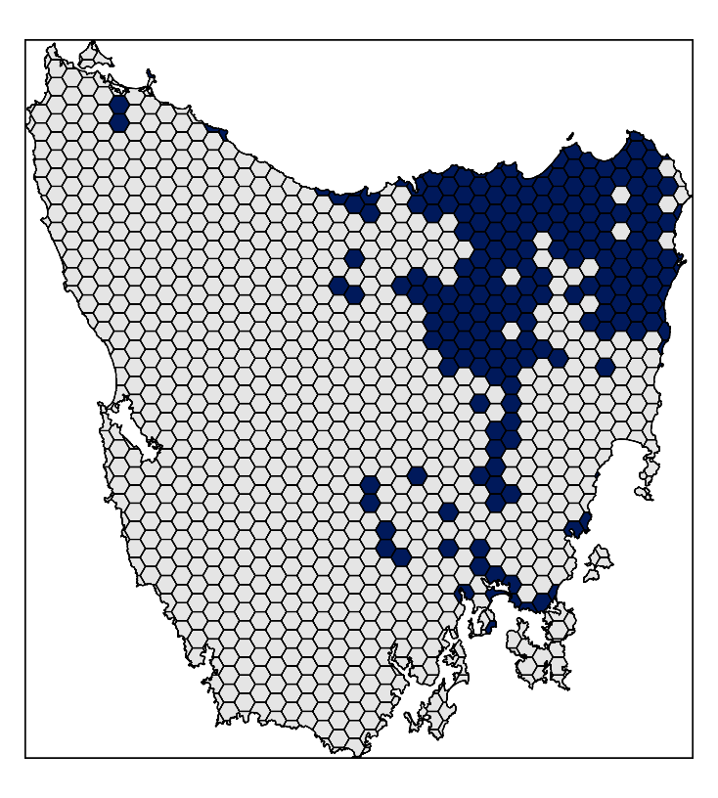
Design your problem
problem(tas_pu, tas_features,
"cost") %>%
add_min_set_objective() %>%
add_relative_targets(0.1) %>% add_locked_in_constraints("in") %>%
add_locked_out_constraints("out") %>%
add_binary_decisions() %>%
add_gurobi_solver(gap = 0) %>% solve()

Slide 24
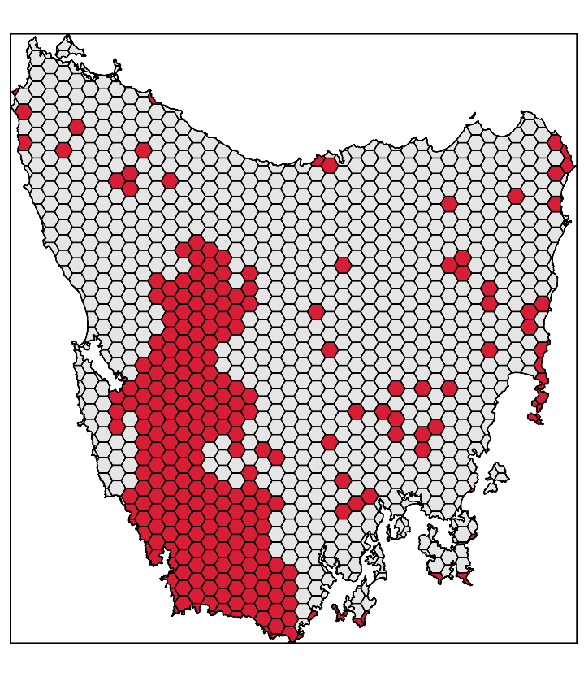
Design your problem
problem(tas_pu, tas_features,
"cost") %>%
add_min_set_objective() %>%
add_relative_targets(0.1) %>% add_locked_in_constraints("in") %>%
add_locked_out_constraints("out") %>%
add_binary_decisions() %>%
add_gurobi_solver(gap = 0) %>% solve()

Slide 25
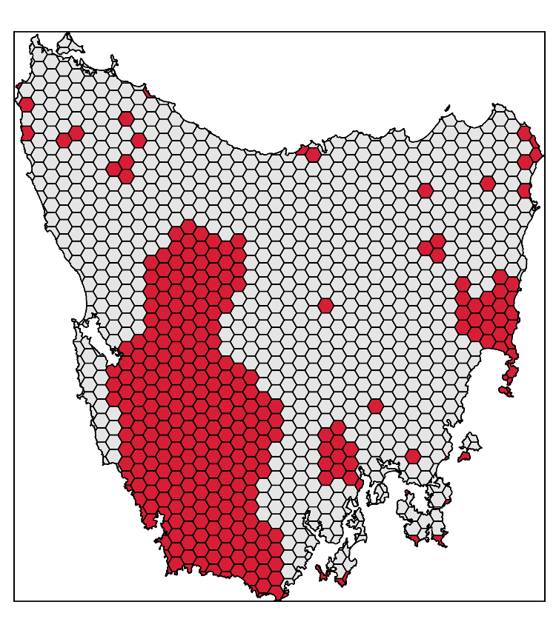
Design your problem
problem(tas_pu, tas_features,
"cost") %>%
add_min_set_objective() %>%
add_relative_targets(0.1) %>% add_locked_in_constraints("in") %>%
add_locked_out_constraints("out") %>%
add_boundary_penalties(0.01, 0.5) %>%
add_binary_decisions() %>%
add_gurobi_solver(gap = 0) %>% solve()

Slide 26
Design your problem
problem(pu, fts, "cost") %>%
add_min_set_objective() %>%
add_relative_targets(…) %>% add_binary_decisions() %>%
solve()
Single zone
problem
problem(pu, zones(fts_z1, fts_z2, …),
c("cost_1", "cost_2", …)) %>%
add_min_set_objective() %>%
add_relative_targets(…) %>% add_binary_decisions() %>%
solve()
Multi-zone
problem

Slide 27
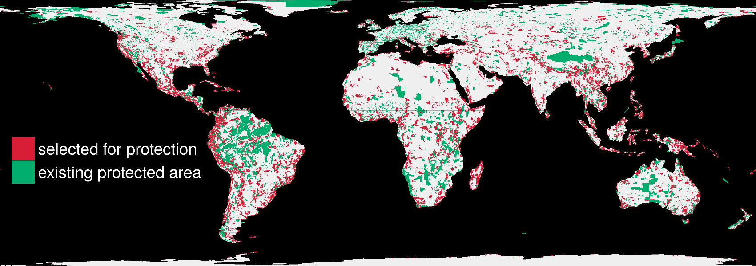
Solve it fast!
1.5 million planning units + 22,644 species: 76 minutes

Slide 28
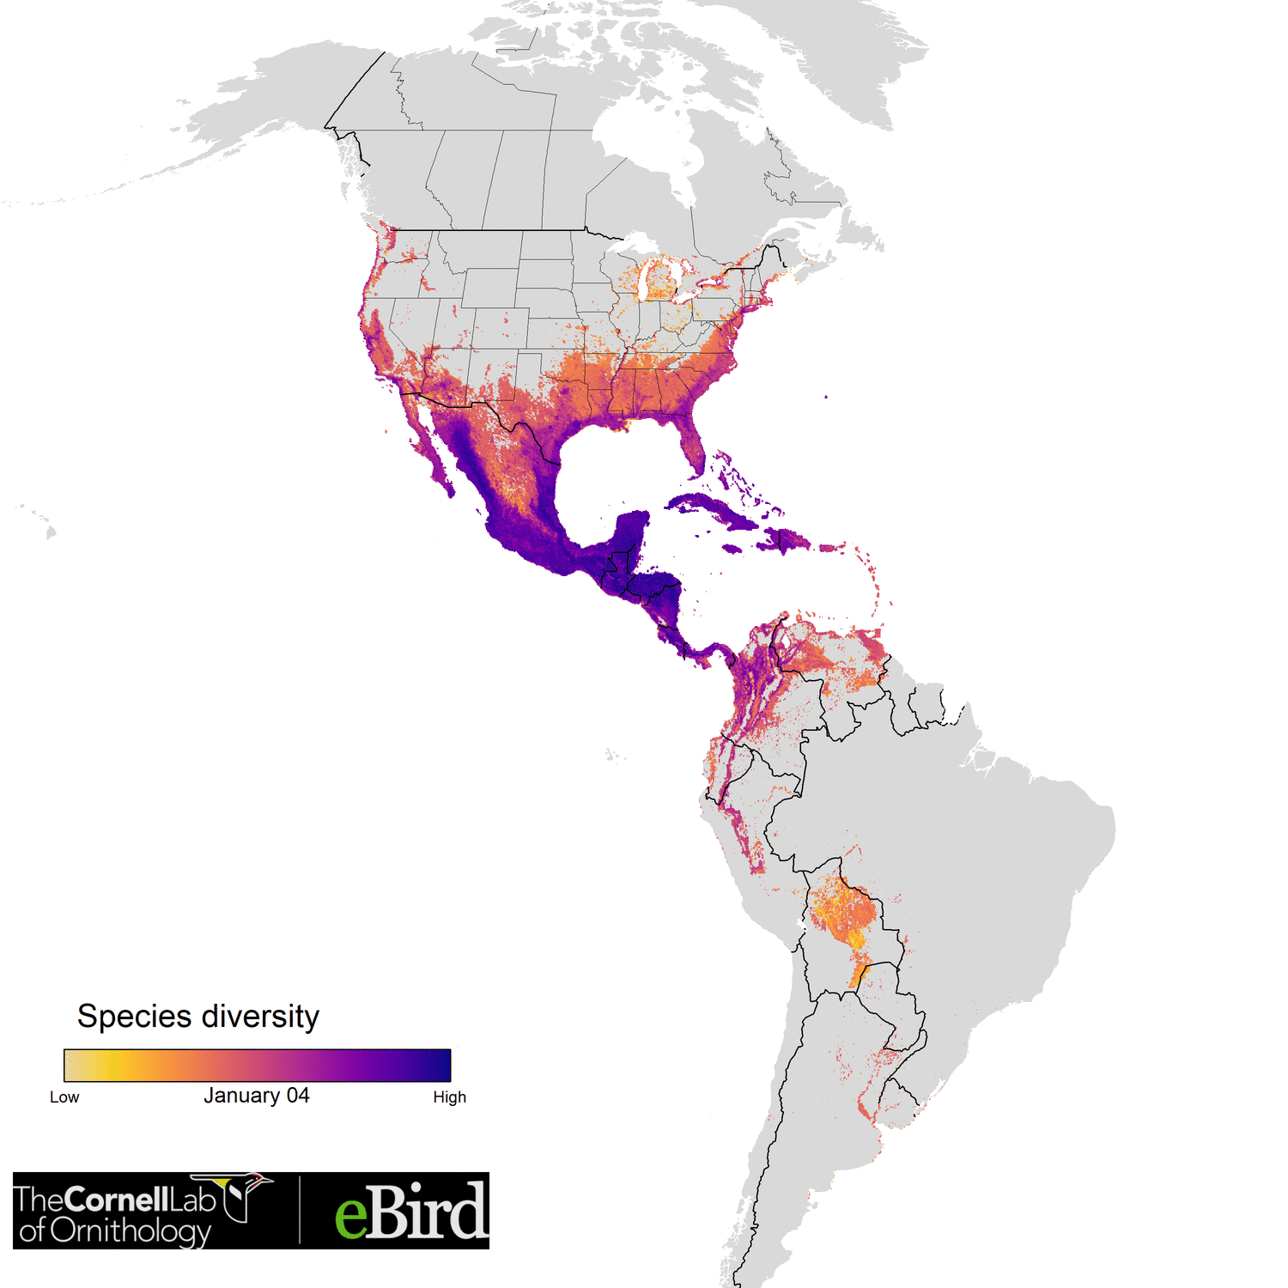

Optimizing the conservation of migratory species over their full annual cycle
117 species
73 million km²
1.7 million unique locations
14 million checklists
≤ 30,420 features
1.05 million planning units
Analysis powered by:
Schuster et al. (2019) Nature Communications

Slide 29

Marxan
prioritizr
Completely free
Lots of resources
Solves a specific problem
100k planning units limit
SPF calibration
Solution quality unknown
Need to run 1k+ times
Point-and-click
Free but you really want Gurobi
Documented (few papers yet)
Solves lots of different problems
>5M planning units
No SPF calibration
Solution quality guaranteed
Run once
Minor programming skills
There is no clear winner: trade-offs!

Slide 30

The vision
Flexible + powerful framework
+ User friendly (browser) interface
= A novice stakeholder can devise a high-quality, data-driven spatial plan in just one hour.
prioritizr.net

Slide 31


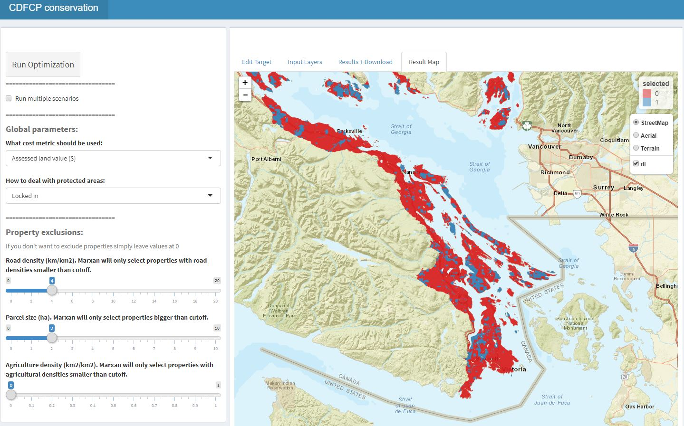
Making prioritizr user friendly:

Slide 32











Facilitate Consensus Decisions on Protection

Slide 33






Climate Adaptive Planning for British Columbia
Recently started 3 year project
Leads: Oscar Venter and Peter Arcese
Partners:

Slide 34
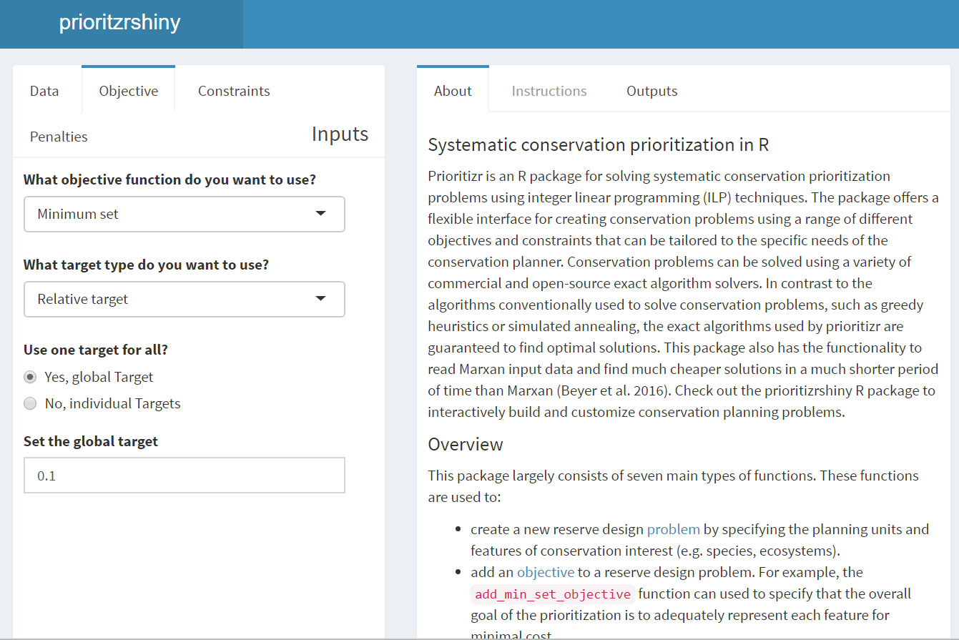
prioritizrshiny (in development)
Code
User interface
p <- problem(areas, feats) %>%
add_min_set_objective() %>%
add_relative_targets(0.1) %>%
add_boundary_penalties(5) %>%
add_binary_decisions() %>%
add_rsymphony_solver()
solution <- solve(p)

Slide 35
Take home message
Flexible + powerful framework
+ User friendly browser interface
= A novice stakeholder can devise a high-quality, data-driven spatial plan in just one hour.
prioritizr.net
jeffrey.hanson@uqconnect.edu.au
richard.schuster@glel.carleton.ca

